Slide 1

Codebasics Resume Project Challenge
Provide Insights to the Marketing Team in Food & Beverage Industry
Rohit Udageri

Slide 2



OVERVIEW
Problem Statement
Data
Insights
Recommen-dations

Slide 3

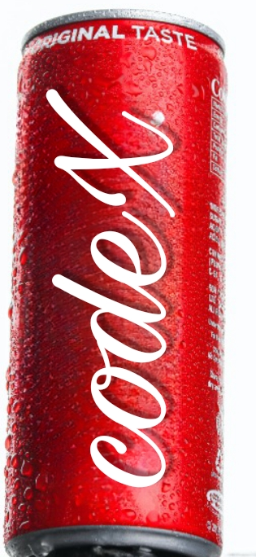
What is CodeX ?
Goal?
Codex is a German beverage company that is aiming to make its mark in the Indian market.
As a marketing data analyst, my goal is to provide valuable insights to our Marketing Team that will help drive strategic actions.
A few months ago, they launched their energy drink in 10 cities in India.
Also to answer the questions given by codebasics team by analyzing the data
They conducted a survey in those 10 cities and received results from 10k respondents.

Slide 4
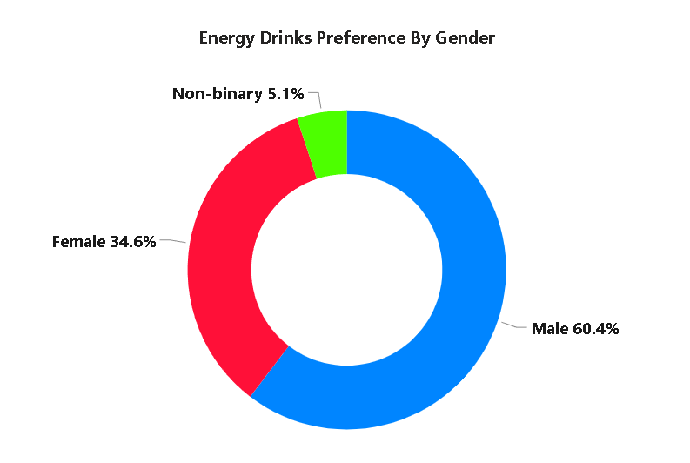
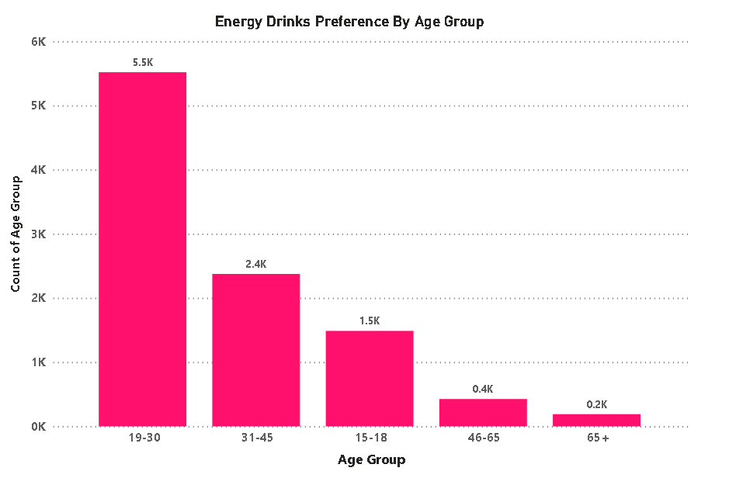
Who prefers energy drink more?
Which age group prefers energy drinks more?
This indicates that Male has a greater inclination towards energy drinks.
This suggests that 19-30 age group has a stronger affinity towards energy drinks.

Slide 5
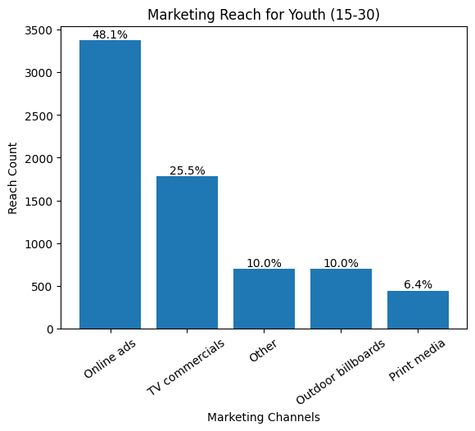

Which type of marketing reaches the most Youth (15-30)
we find that online ads has the highest reach among the youth, making it an effective strategy to engage with this target audience

Slide 6
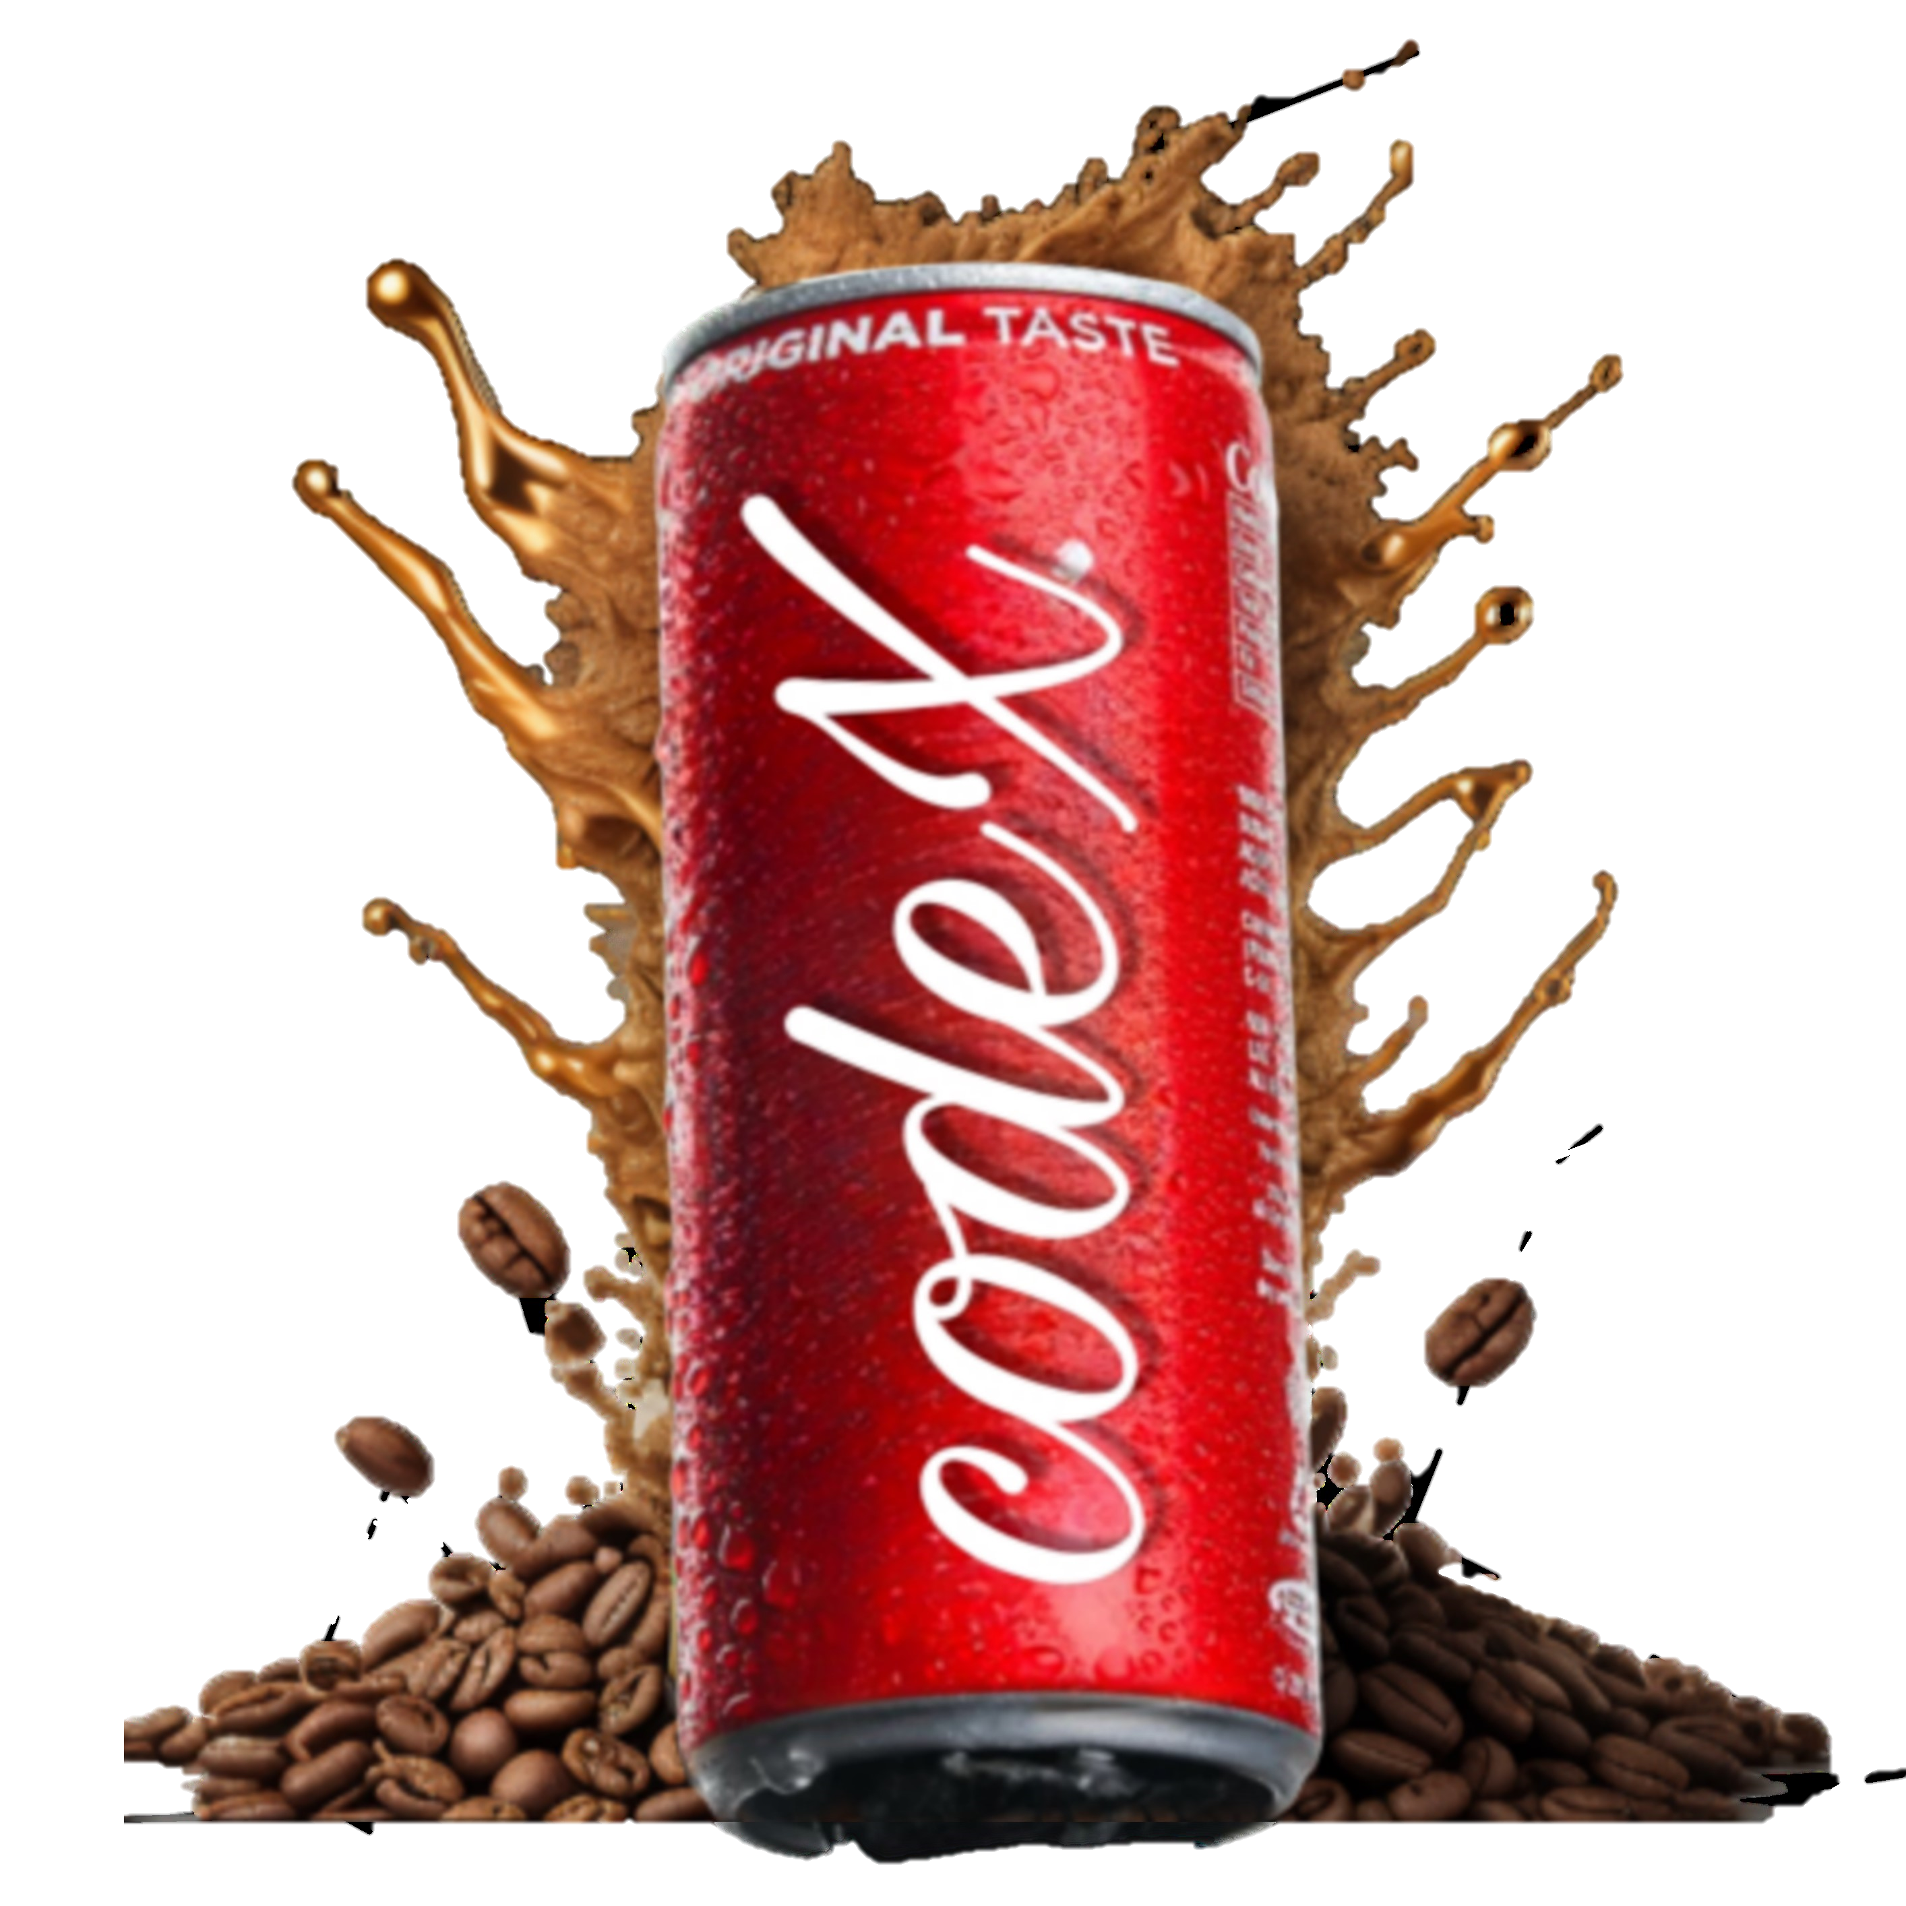
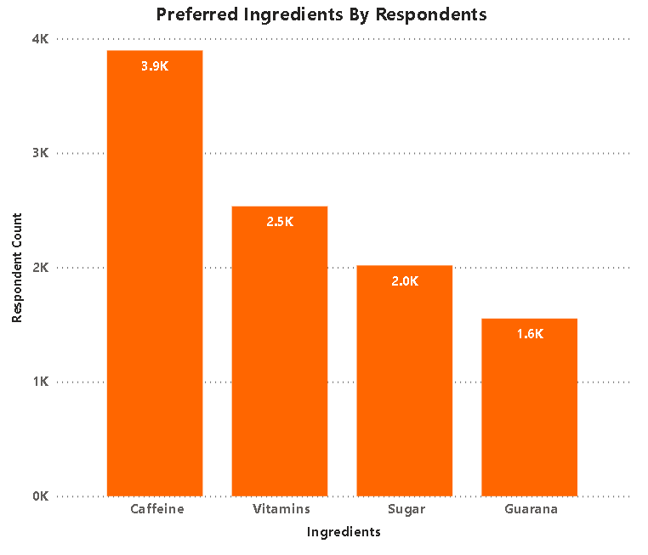
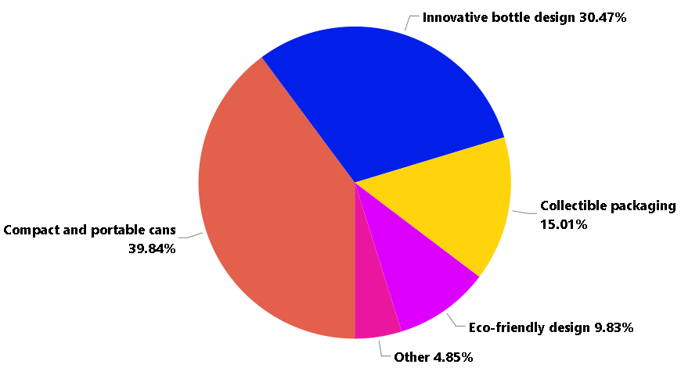
What are the preferred ingredients of energy drinks among respondents?
What packaging preferences do respondents have for energy drinks?
we can observe that Caffeine are highly preferred by respondents.
The pie chart shows that around 40% of respondents prefer compact & portable cans.

Slide 7
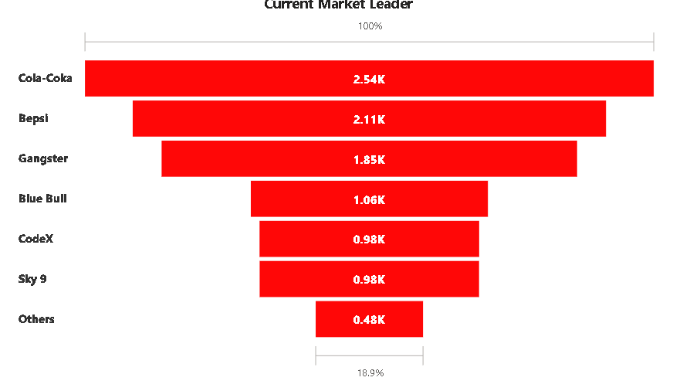
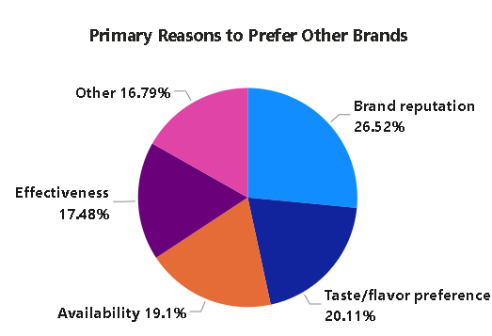
Who are the current market leaders?
Who are the current market leaders?
What are the primary reasons consumers prefer those brands over ours
we can see that Cola-Coka hold the highest market shares, establishing their dominance in the industry.
The pie chart highlights the primary reasons cited by respondents for preferring the competing brands.

Slide 8
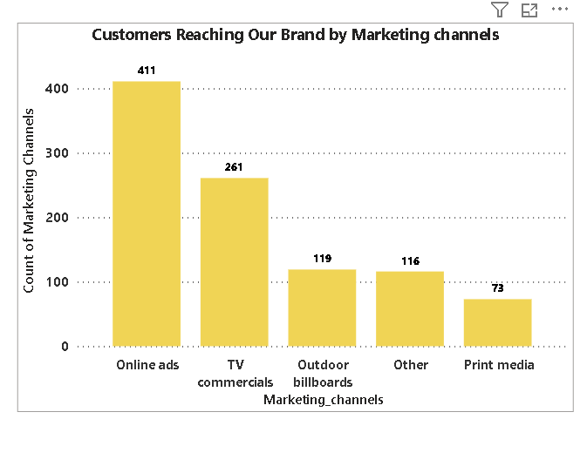
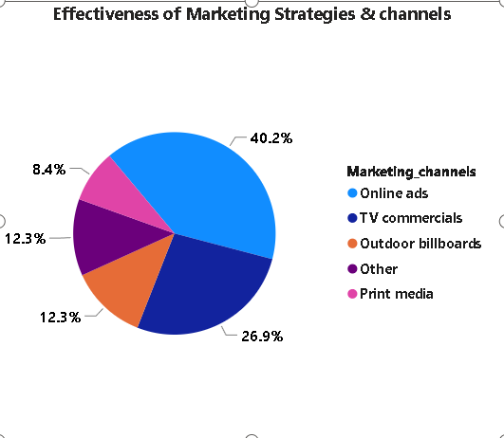
Which marketing channel can be used to reach more customers?
How effective are different marketing strategies and channels in reaching our customers?
The chart illustrates the effectiveness of Online ads in terms of reaching target customers.
For CodeX the most effective strategies and channels for reaching our customers is online ads which is around 41% .

Slide 9
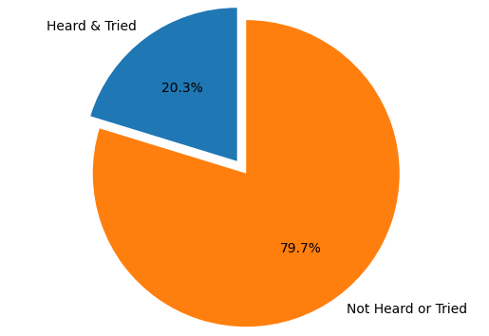
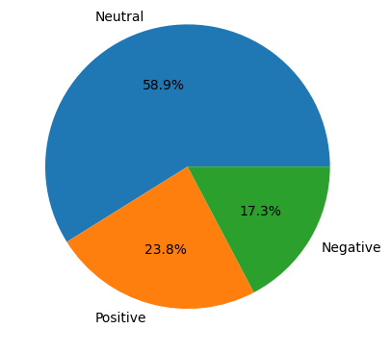
What do people think about our codeX brand? (overall rating)
10K Respondents
4.4K Respondents Heard about Codex
2K Respondents Tried the drink
For CodeX the most effective strategies and channels for reaching our customers is online ads which is around 41% .

Slide 10
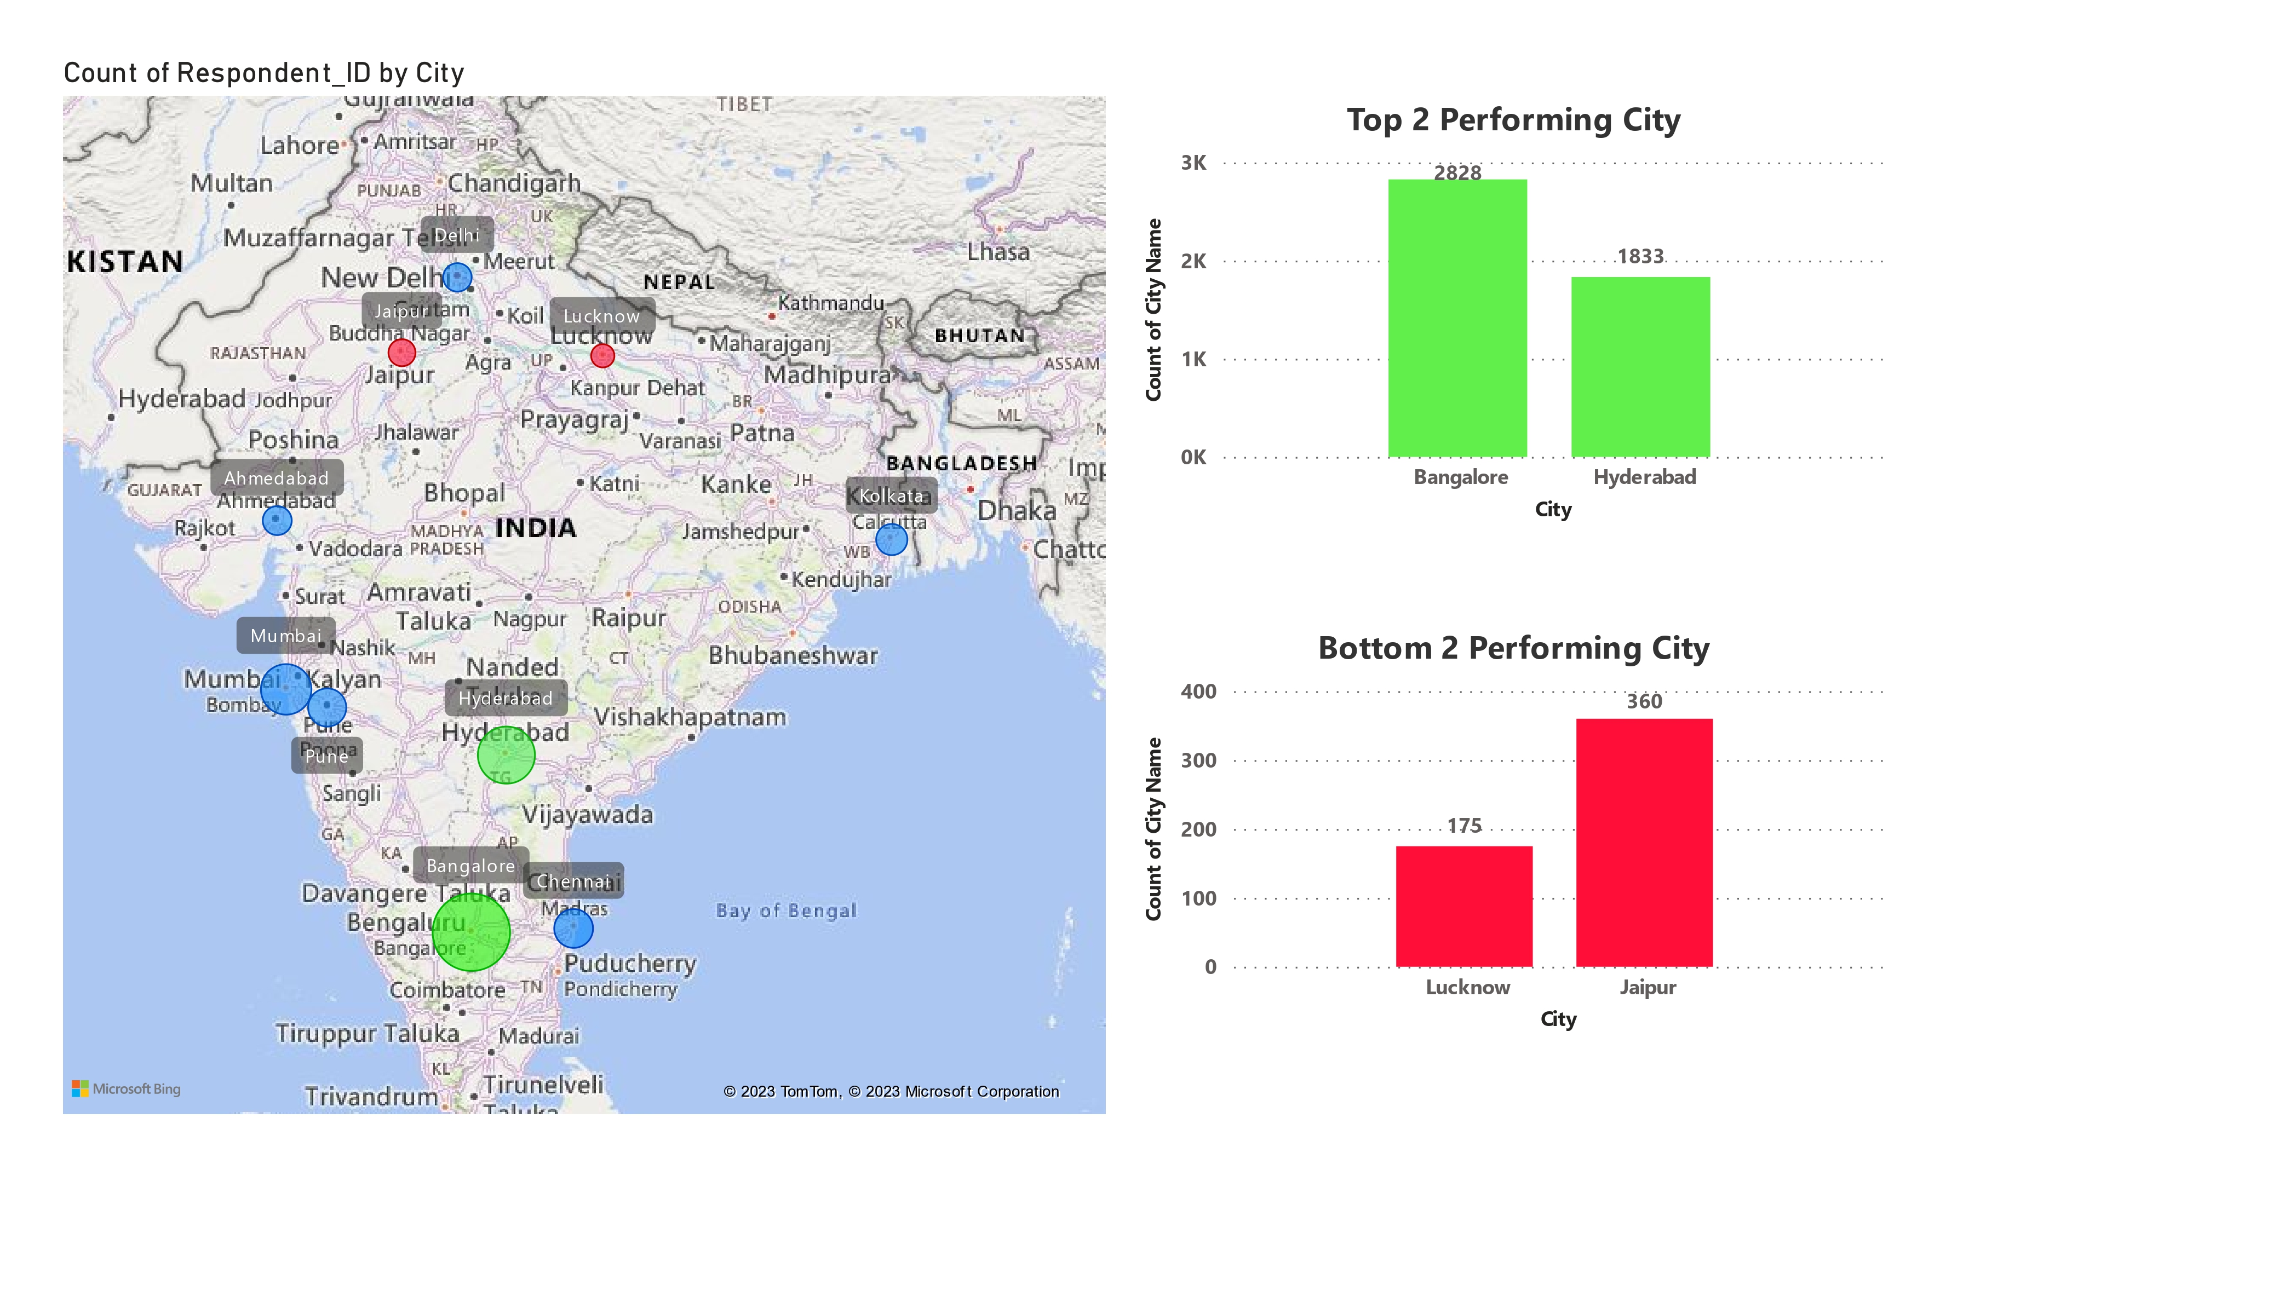
Which cities do we need to focus more on?

Slide 11
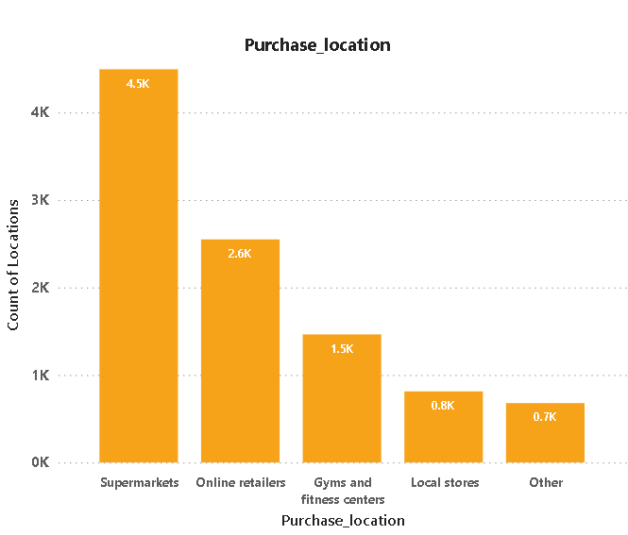
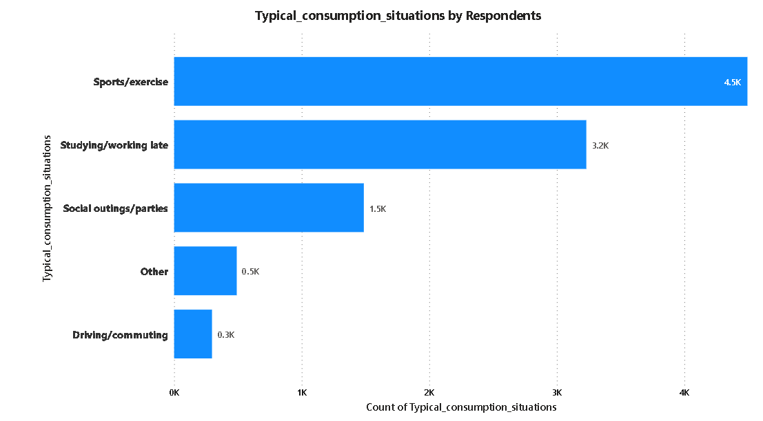
Where do respondents prefer to purchase energy drinks?
What are the typical consumption situations for energy drinks among respondents?
The chart shows that around 45% of respondents consumption situation of energy drink is during sports/exercise.
we can observe that supermarkets are highly preferred by respondents as a purchase location.

Slide 12
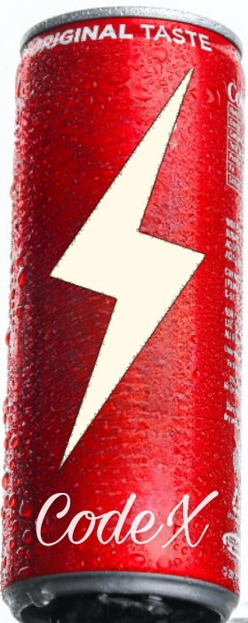
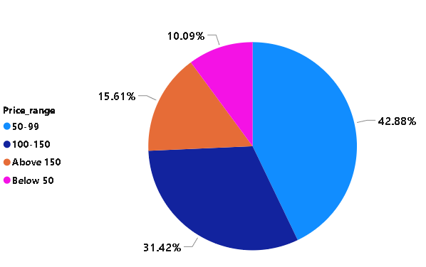
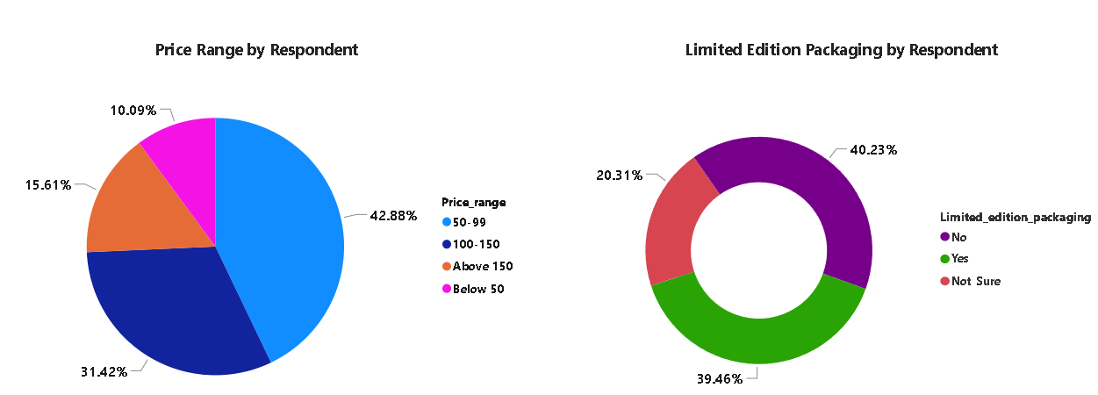
What factors influence respondents' purchase decisions, such as price range and limited edition packaging?
Price Range
limited edition packaging
we can observe that price range between 50-99 are highly preferred by respondents.
The chart shows that 40% of respondents for limited edition packaging is No and also 39.5 % with Yes.

Slide 13
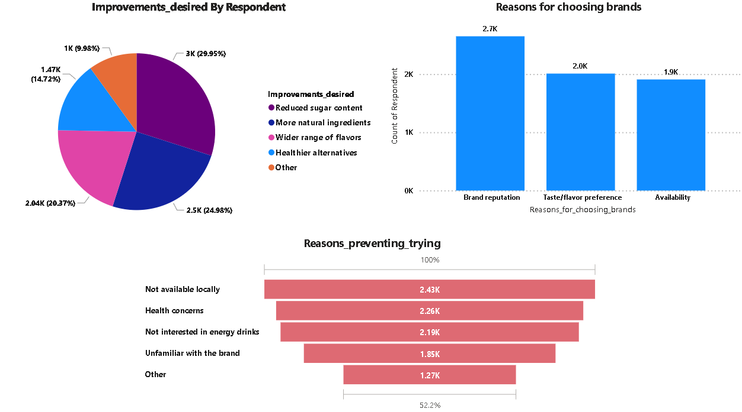
Which area of business should we focus more on our product development? (Branding/taste/availability)

Slide 14
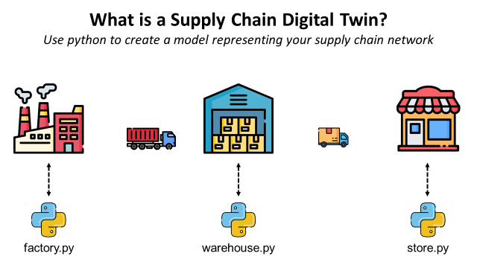
Recommendations
Our Goal is :
To Increase Brand awareness
To reach large number of audience
2.Add Range of Flavours
Try to add Indian flavours to energy drinks, like
Kokam
Aanar
Guava
Aamras
1.Supply Chain
3.Target Audience
People of age group 19-30
Athlete, health freaks.
Late night Hustlers
Around 24% of respondents prevent trying our product due Non-availability of product locally

Slide 15
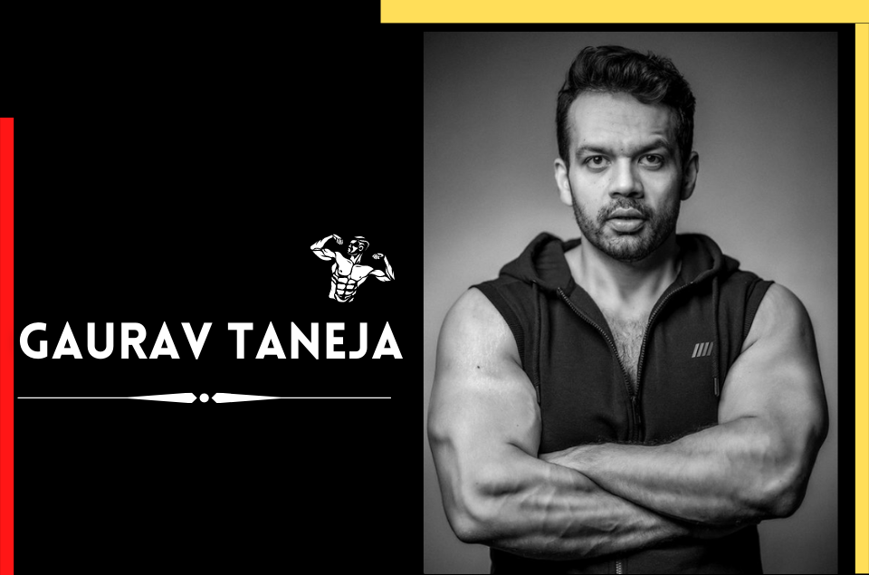

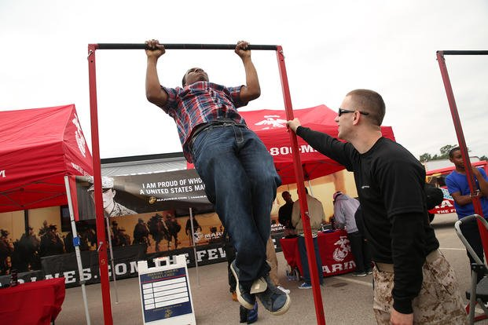
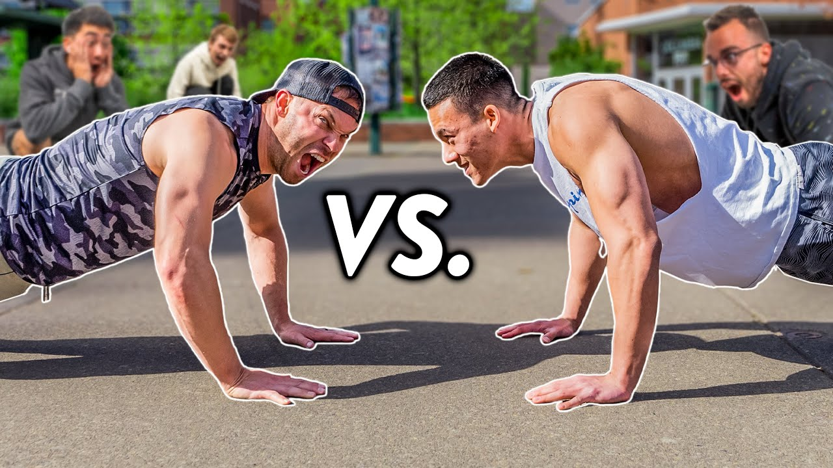
Marketing Campaigns
Focusing on Brand Building
1) Mainly we should focus on Building the Brand reputation , as only 44% of people heard about codeX brand & only 20% of them have tried it.
2) Utilize online ads, social media campaigns, influencer collaborations, and targeted digital marketing strategies to increase brand awareness, and create a strong online presence.
3) Instead of giving discounts and offers , we should run a campaign called codeX fitness challenge competitions in colleges , university campus , sports academy’s etc (for eg, most pushups in 1 min , ).

Slide 16
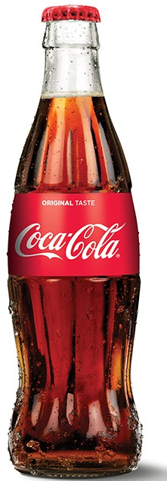
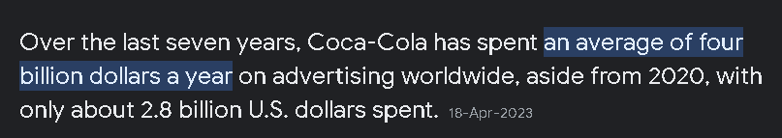

Build Emotional Connections
How coca cola become the market leader ?
Tangible Value
Perceived Value
The Real value of product
How it is able to enhance perception of product in minds of people
Coke ki Khushi , Cricket ki Khushi
Great Product

Slide 17

Video credits : Coca-Cola India

Slide 18
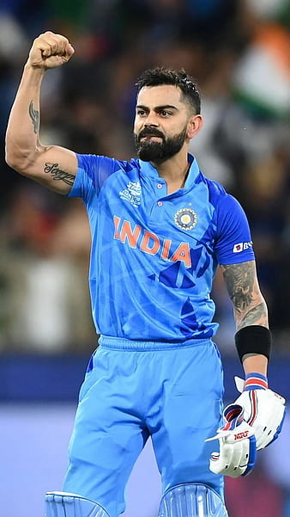
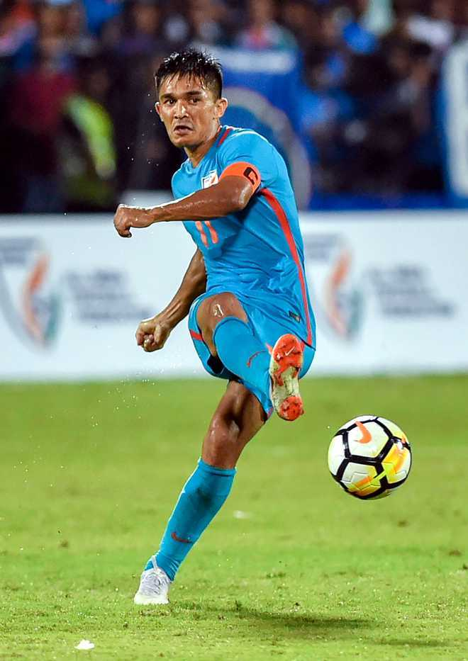
What I understood is ?
1) Brands sells an emotion
2) It’s okay if we not talk too much about specification, telling a great story is important.
Brand Ambassador for codeX
Fitness Icons
Gym Enthusiasts
Both are widely recognized as fitness icons and role models in the sports industry. As brand ambassadors, they can inspire consumers to adopt a healthy and active lifestyle, positioning CodeX energy drinks as a choice that aligns with their fitness goals.

Slide 19



Mr. Dhaval Patel
Founder
Mr. Hemanand Vadivel
Co-Founder

